Slide 1
CPYTHON Interpreter
18CSC304J – Compiler Design

Slide 2
Team members
SHAIK HUSSIAN AHAMED(RA2011003010439)
S JAHNAVI(RA2011003010457)

Slide 3
Introduction
Cpython is the default and widely used implementation of the Python programming language. It is an interpreter that translates Python code into machine-readable bytecode that can be executed on a computer. CPython is written in C and is known for its simplicity, ease of use, and compatibility with a wide range of platforms. It includes a standard library of modules and tools that make it easier for developers to create and run Python programs. CPython is open source and has an active community of contributors who work to improve and maintain the language.

Slide 4
PROBLEM STATEMENT
We need to save the file path returned by askopenfilename within tkinter filedialog for later use I trigger the function openFile via a button which define and expect this function to store the requested file's path, I tried using global variable and StringVar() too but It didn't work it gives empty string, the global variable path is where I need file path string.

Slide 5
Methodology
Several phases go into the creation of CPython, including planning, design, coding, testing, and release. Agile and Waterfall techniques are combined in the CPython development process. Agile development practices place a strong emphasis on incremental and iterative development, frequent releases, and close cooperation between developers and stakeholders. This strategy is used by the Python core development team, which updates Python on a regular basis and engages in open communication with the public to solicit feedback and proposals for enhancements.

Slide 6
The team also manages the production of significant releases using the Waterfall technique at the same time. The Waterfall model is a sequential design process that follows a linear approach; each stage must be finished before going on to the next. For large Python releases that require sizable changes to the language, this technique is employed.

Slide 7
REQUIREMENTS
SOFTWARE REQUIREMENTS:
Windows/Operating System
Python (tkinter) Programming Language
HARDWARE REQUIREMENTS :
Minimum of 4GB RAM

Slide 8
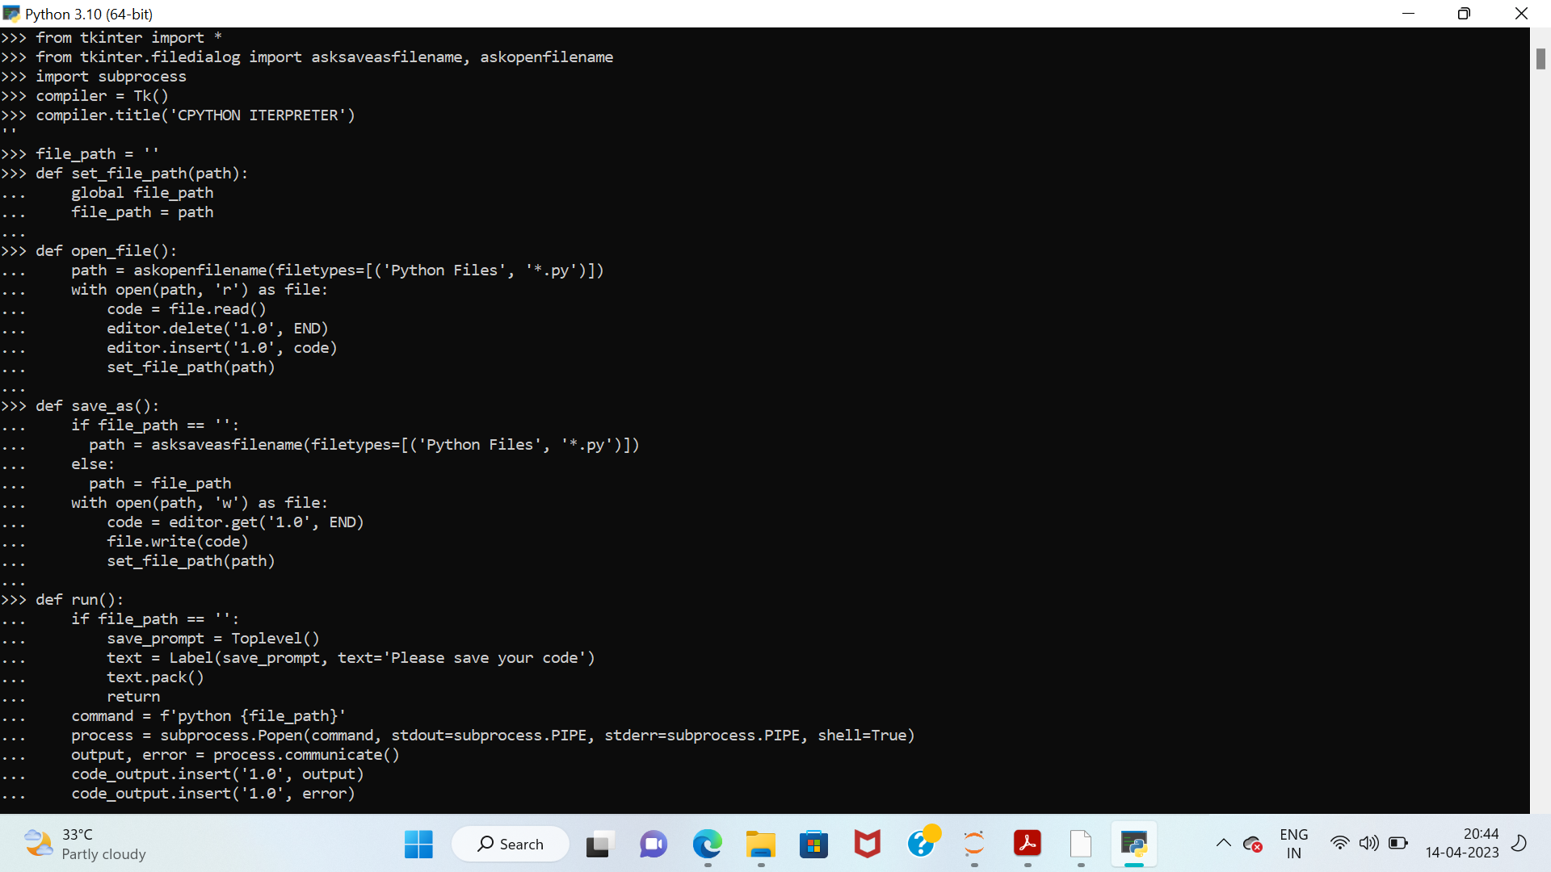
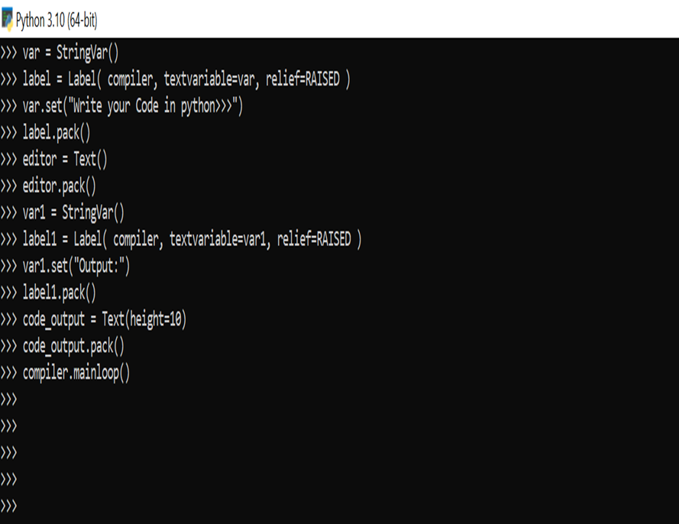
SOURCE CODE

Slide 9
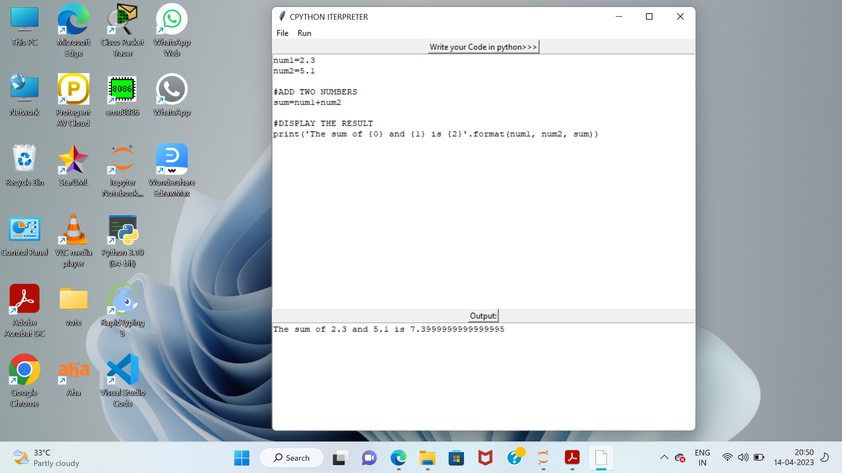
Result

Slide 10
CONCLUSION
CPython remains a popular choice among Python developers due to its simplicity and ease of use, as well as its vast array of libraries and packages. Its open-source nature also means that it is continually being improved and updated by the community, ensuring that it remains relevant and useful for years to come.

Slide 11
Thank you

